Slide 1
Instruction Types

Slide 2
Classification of computer instructions
Most computer instructions can be classified into three categories:
  Data transfer instructions
  Data manipulation A & L Instructions
  Program control instructions
  I/O Instructions

Slide 3
1. Data Transfer Instruction
Move data from one place to another without changing the data content in the computer.
Different data transfers:
  Memory ↔ processor registers
  Processor registers ↔ input or output
  Processor register ↔ processor register

Slide 4
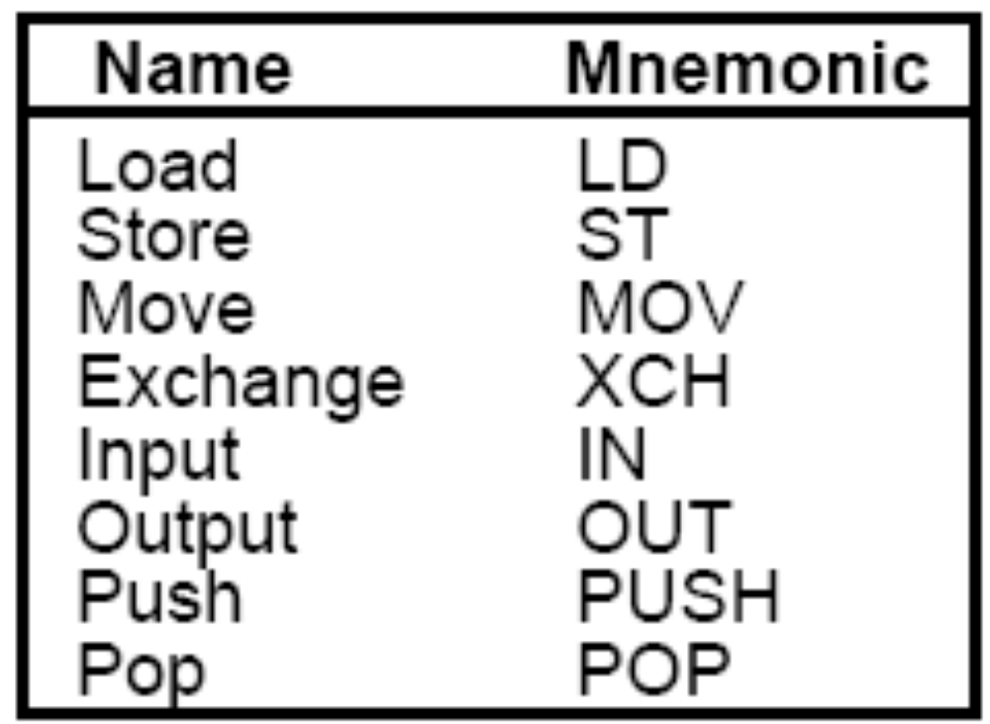
Data Transfer

Slide 5
1. Data Transfer Instruction cont..
Load: transfer from memory to a processor register, usually an AC (memory read)
Store: transfer from a processor register into memory (memory write)
Move: transfer from one register to another register
Exchange: swap information between two registers or a register and a memory word
Input/Output: transfer data among processor registers and input/output device ( I/O instructions)
Push: transfer data between processor registers and a memory stack
Pop : transfer data from stack to processor registers.

Slide 6
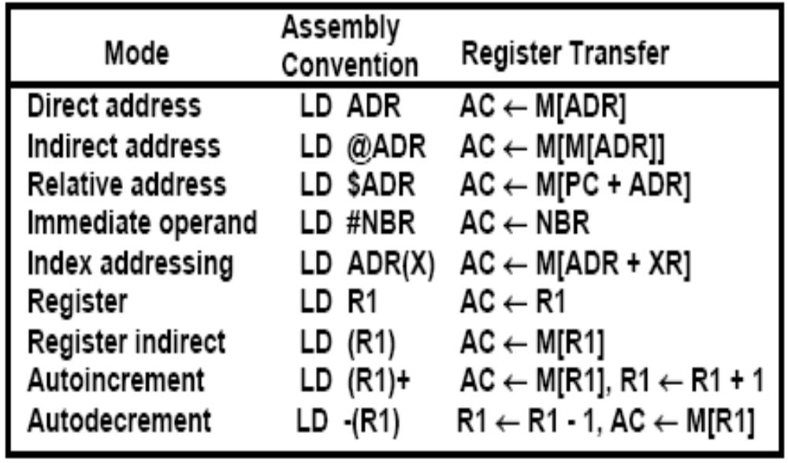
LOAD Instructions in Different Addressing Modes

Slide 7
2. Data Manipulation Instruction
Perform operations on data and provide the computational capabilities for the computer.
    Arithmetic,
    Logical and bit manipulation,
    Shift Instruction

Slide 8
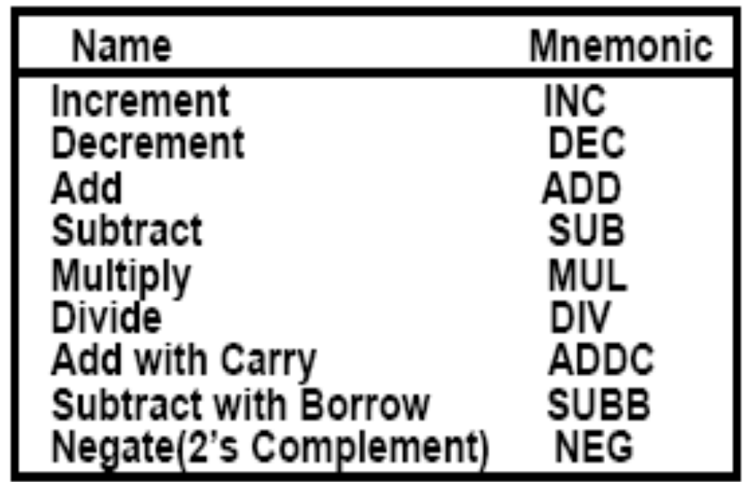
I. Arithmetic Instructions cont..

Slide 9
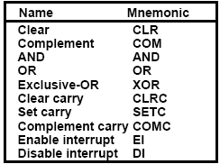
II. Logical and Bit Manipulation Instructions cont..

Slide 10
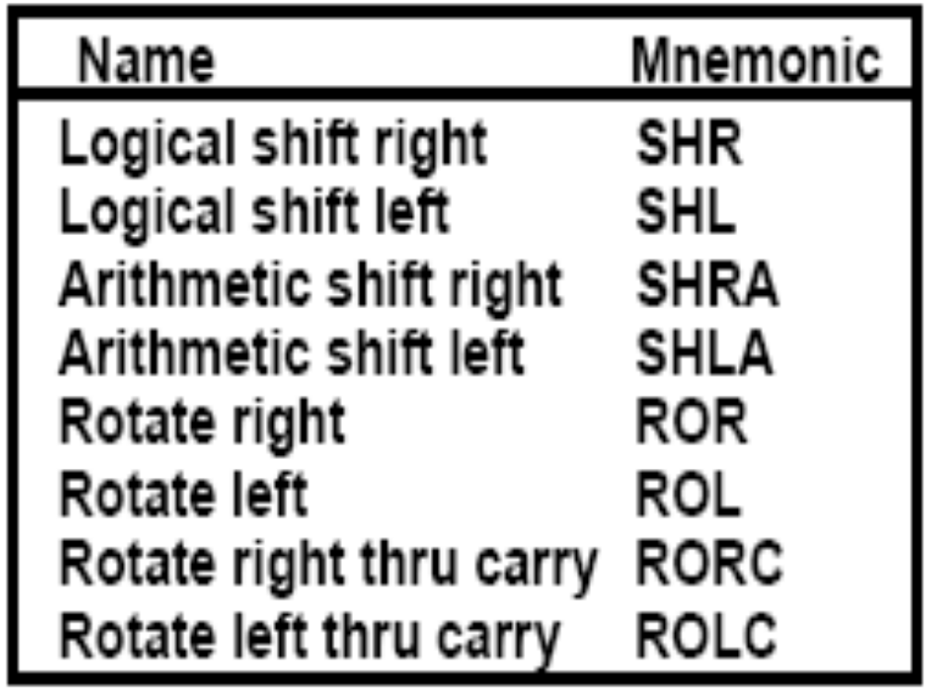
III. Shift Instructions cont..

Slide 11
Logical shift left
0
0
0
1
1
0
1
0
0
0
0
1
1
0
1
0
Shift by 1 bit towards left
0
0
0
1
1
0
1
0
0
After shifting two times
0
After shifting three times
0
1
1
0
1
0
0
0
0

Slide 12
Logical shift Right
0
0
0
1
1
0
1
0
0
0
0
0
1
1
0
1
0
Shift by 1 bit towards right
0
0
0
0
0
1
1
0
1
After shifting two times
After shifting three times
0
0
0
0
0
0
1
1
0

Slide 13
Arithmetic shift left
0
0
0
1
1
0
1
0
Sign bit
0
0
0
1
1
0
1
0
Shift by 1 bit towards left
Sign bit
0
0
0
1
1
0
1
0
0
After shifting two times
Sign bit
0
After shifting three times
0
1
1
0
1
0
0
0
Overflow occurs as
sign bit changes
Sign bit
0

Slide 14
Arithmetic shift Right:
-ve values are in 2’s complement form
1
0
0
1
1
0
1
0
Sign bit
1
1
0
0
1
1
0
1
0
Shift by 1 bit towards right
Sign bit
1
1
0
0
1
1
1
After shifting two times
1
0
Sign bit
After shifting three times
1
1
1
1
0
0
1
1
0
Sign bit

Slide 15
Rotate left
0
0
0
1
1
0
1
0
0
0
0
1
1
0
1
0
Rotate by 1 bit towards left
Buffer
0
0
1
1
0
1
0
0
After rotating two times
Buffer
After rotating three times
0
1
1
0
1
0
0
0
Buffer

Slide 16
Rotate right
0
0
0
1
1
0
1
0
rotate by 1 bit towards right
0
0
0
1
1
0
1
0
Buffer
0
0
0
0
1
1
0
1
After rotating two times
Buffer
After rotating three times
1
0
0
0
0
1
1
0
Buffer

Slide 17
Rotate left through carry
0
0
0
1
1
0
1
0
Rotate by 1 bit towards left
0
0
0
1
1
0
1
0
0
Buffer
Carry
0
0
1
1
0
1
0
0
0
After rotating two times
Buffer
Carry
After rotating three times
0
1
1
0
1
0
0
0
0
Buffer
Carry

Slide 18
Rotate right through carry
0
0
0
1
1
0
1
0
rotate by 1 bit towards right
0
0
0
0
1
1
0
1
0
Carry
Buffer
0
0
0
0
0
1
1
0
1
After rotating two times
Carry
Buffer
After rotating three times
0
1
0
0
0
0
1
1
0
Carry
Buffer

Slide 19
3. Program control Instructions
Operation Name | Description
Jump Unconditional | Unconditional transfer
Jump | Test specified condition
Jump to subroutine | Jump to specified address
Return | Replace the content of PC
Execute | Execute instructions
Skip | Increment PC to skip next Instruction
Skip condti | Test conditon for skip
Halt | Stop program execution
Wait (hold) | Stop program execution and resume when condition satisfied
No operation | No operation performed but program execution continued

